Slide 1
CELEBAL PROJECT
Project Name :- Configration Point-to-Site VPN
Group Name :- Cloud-6
Project Team :- Cloud
Department :- School of Computer Science & Engineering
Submitted By :- TASNEEM FATIMA (MCA 2nd Year) , VINAYAK SAIN (B-Tech[CS] 4th Year),
ANKIT LALAWAT(BCA 3rd Year), YOGESH MANDORA (MCA 2nd Year)
Submitted To :- MISS REEMA RANI

Slide 2
Point-to-Site VPN

Slide 3
INTRODUCTION
Point-to-Site VPN connections are useful when you want to connect to your VNet from a remote location, such when you are telecommuting from home or a conference. You can also use P2S instead of a Site-to-Site VPN when you have only a few clients that need to connect to a VNet. Point-to-Site connections do not require a VPN device or a public-facing IP address. P2S creates the VPN connection over either SSTP (Secure Socket Tunneling Protocol), or IKEv2.
A Point-to-Site (P2S) VPN gateway connection create a secure connection to your virtual network from an individual client computer.

Slide 4
Terminologies
RESOURCES GROUPS
VIRTUAL NETWORK
SUBNET
GATEWAY SUBNET
VIRTUAL NETWORK GATEWAY
VIRTUAL MACHINE

Slide 5
RESOURCES GROUPS
Azure Resources Groups are logical collections of virtual machines, storage accounts, virtual networks, web apps, databases, and database servers. Typically, users will group related resources for an application, divided into groups for production and non-production — but you can subdivide further as needed.
There are several ways to create an Azure Resource Group, or in other words, several ways to actually manage using the Azure Resource Manager. They are:
The Azure Portal
Azure PowerShell scripts
VIRTUAL NETWORK
An Azure Virtual Network (VNet) is a representation of your own network in the cloud. It is a logical isolation of the Azure cloud dedicated to your subscription. You can use VNets to provision and manage virtual private networks (VPNs) in Azure and, optionally, link the VNets with other VNets in Azure, or with your on-premises IT infrastructure to create hybrid or cross-premises solutions.
The VNet service enables Azure resources to securely communicate with each other in a virtual network.

Slide 6
SUBNET
A subnet is a range of IP addresses in the VNet. You can divide a VNet into multiple subnets for organization and security. Each NIC in a VM is connected to one subnet is one VNet. NICs connected to subnets (same or different) within a VNet can communicate with each other without any extra configration.
By default, there is no security boundary between subnets, so VMs in each of these subnets can talk to one another. However, you can set up Network Security Groups(NSGs), which allow you to control the traffic flow to and from subnets end to end from VMs.
GATEWAY SUBNET
The virtual network gateway uses specific subnet called the gateway subnet.The gateway subnet is part of the virtual network IP address range that you specify when configuring your virtual network. It contains the IP addresses that the virtual network gateway resources and services use. When you create the gateway subnet, you specify the number of IP addresses that the subnet contains.
The virtual network gateway is held in its own subnet,which is subject to various requierment.

Slide 7
VIRTUAL NETWORK GATEWAY
A virtual network gateway is composed of two or more VMs that are deployed to a specific subnet you create called the gateway subnet. Virtual network gateway VMs contain routing tables and run specific gateway services. These VMs are created when you create the virtual network gateway. You can't directly configure the VMs that are part of the virtual network gateway.
When you configure a virtual network gateway, you configure a setting that specifies the gateway type. The gateway type determines how the virtual network gateway will be used and the actions that the gateway takes.
VIRTUAL MACHINE
VM is basically a raw server that you get from your cloud provider. It's like your own personal computer, rather than purchasing it, you are renting it out on the cloud. When you are renting it out on the cloud, it is the same as if you are on your own computer. It's just a fresh piece of operating system, you can install as many software as you want, you can make it be a web server, application server etc. you can configure it to be anything.
Virtual machines are generally used to host applications when the customer requires more control over the computing environment than what is offered by other compute resources. When you leverage a virtual machine to host your application, you get the flexibility of virtualization without the need to buy or maintain any underlying physical hardware.

Slide 8
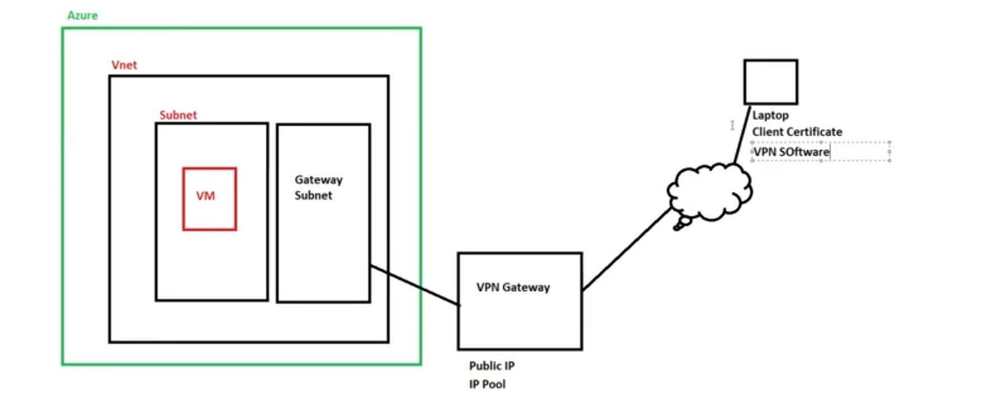

Slide 9
Azure Point-to-Site VPN Steps
Create Resource Group
Create Virtual Network
Create Subnets
Create Gateway Subnet
Create Virtual Network Gateway
Create Self-sign root & client certificate
Configure Point-to-Site Connection
Testing VPN connection

Slide 10

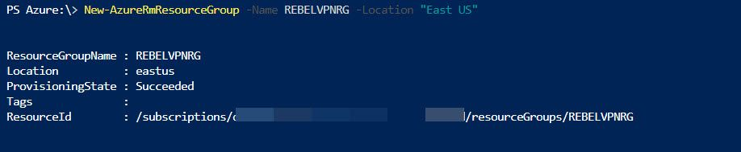
Create Resource Group
Log in to Azure portal as global administrator
Launch Cloud Shell
Then run:- New-AzureRmResourceGroup -Name REBELVPNRG -Location "East US" on cloud shell.
In here REBELVPNRG is resource group name and East US is the location.

Slide 11
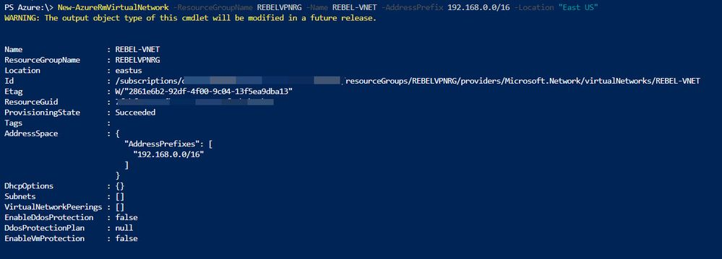
Create Virtual Network
To create new virtual network run :-
New-AzureRmVirtualNetwork -ResourceGroupName REBELVPNRG -Name REBEL-VNET -AddressPrefix 192.168.0.0/16 -Location "East US"
In above, REBEL-VNET is the virtual network name. it uses 192.168.0.0/16 IP address range.

Slide 12
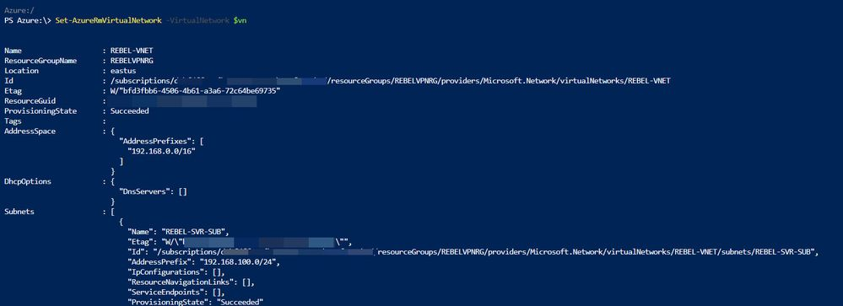
Create Subnets
Under the virtual network I am going to create a subnet for my servers. To create subnet run :-
$vn = Get-AzureRmVirtualNetwork -ResourceGroupName REBELVPNRG -Name REBEL-VNET
Add-AzureRmVirtualNetworkSubnetConfig -Name REBEL-SVR-SUB -VirtualNetwork $vn -AddressPrefix 192.168.100.0/24
Set-AzureRmVirtualNetwork -VirtualNetwork $vn

Slide 13
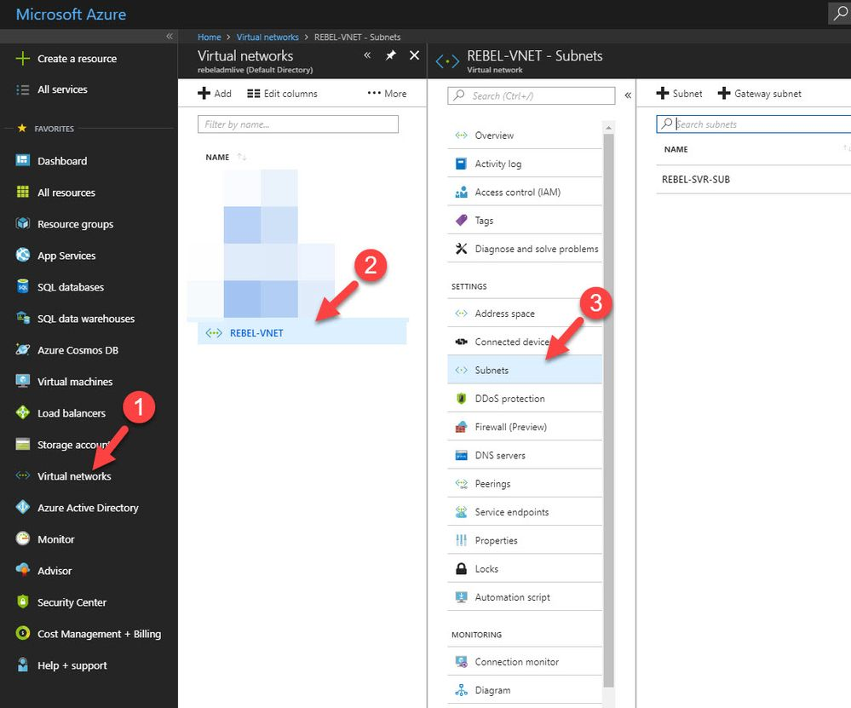
Create Gateway Subnet
Gateway use ip addresses assigned in this subnet.
To do that:-
Log in to Azure portal as global administrator
Go to Virtual Networks | REBEL-VNET (VNet created on previous steps) | Subnets

Slide 14
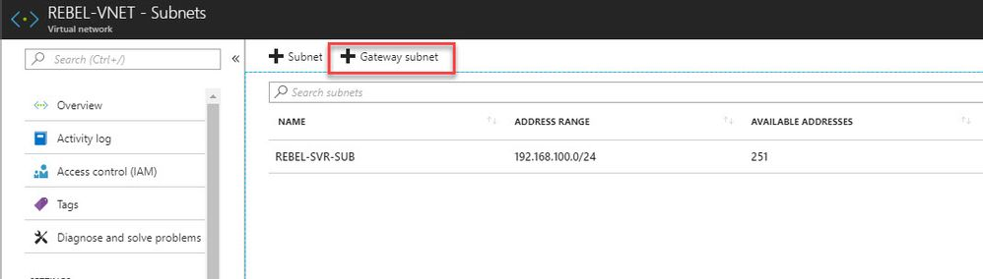
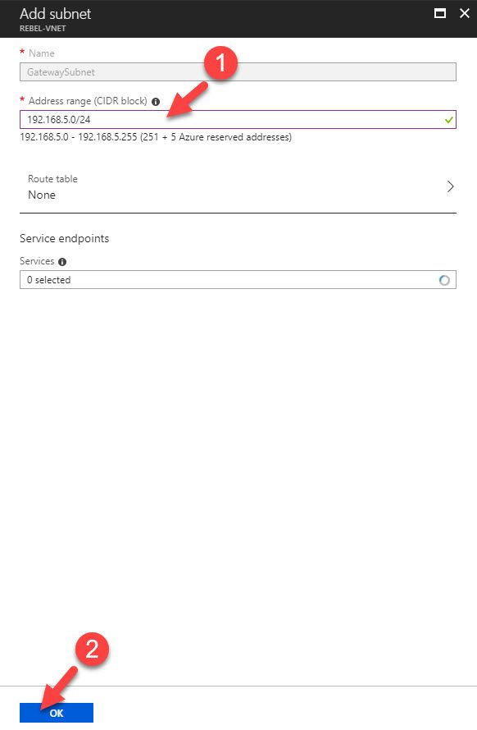
Click on Gateway Subnet.
In new window, define the ip range for gateway subnet and click Ok.

Slide 15
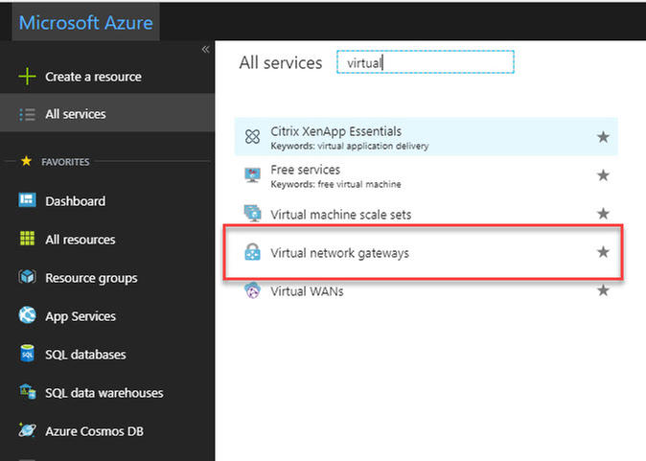
Create Virtual Network Gateway
Now we have all the things needed to create new VN gateway. To do that :-
Log in to Azure portal as global administrator
Go to All Services and search for virtual network gateway. Once it is in list, click on it.

Slide 16
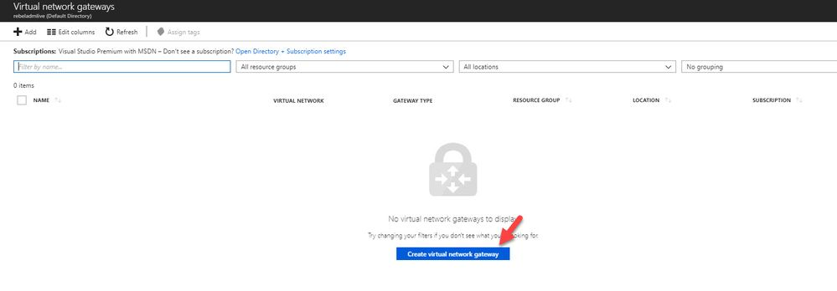
Then click on Create virtual network gateway.

Slide 17
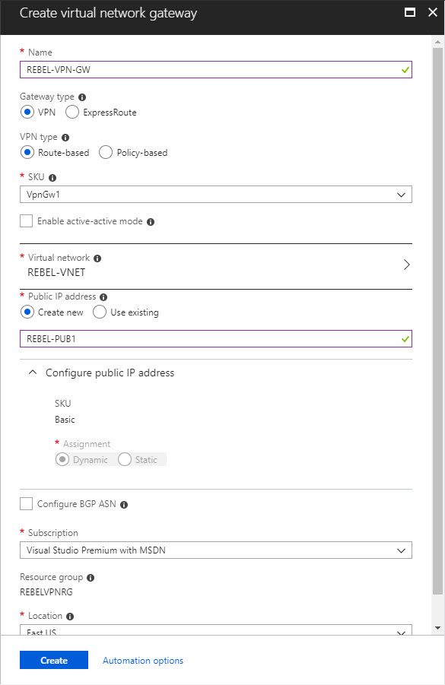
In new window fill relevant info and click on Create:-
In here, REBEL-VPN-GW is the gateway name.
I have selected REBEL-VNET as the virtual network.
I am also creating public ip called REBEL-PUB1. This is only supported with dynamic mode.
This doesn’t mean it is going to change randomly. It will only happen when gateway is deleted or read.

Slide 18
Create Self-sign root & client certificate
In first step I am going to create root certificate. In Windows 10 machine I can run this to create root cert first.
$cert = New-SelfSignedCertificate -Type Custom -KeySpec Signature `
-Subject "CN=P2SRootCert" -KeyExportPolicy Exportable `
-HashAlgorithm sha256 -KeyLength 2048 `
-CertStoreLocation "Cert:\CurrentUser\My" -KeyUsageProperty Sign -KeyUsage CertSign
This will create root cert and install it under current user cert store.
New-SelfSignedCertificate -Type Custom -DnsName P2SChildCert -KeySpec Signature `
-Subject "CN=P2SChildCert" -KeyExportPolicy Exportable `
-HashAlgorithm sha256 -KeyLength 2048 `
-CertStoreLocation "Cert:\CurrentUser\My" `
-Signer $cert -TextExtension @("2.5.29.37={text}1.3.6.1.5.5.7.3.2")

Slide 19
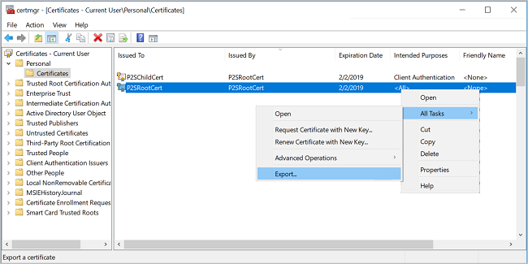
Get-ChildItem -Path "Cert:\CurrentUser\My"
$cert = Get-ChildItem -Path "Cert:\CurrentUser\My\7181AA8C1B4D34EEDB2F3D3BEC5839F3FE52D655"
New-SelfSignedCertificate -Type Custom -DnsName P2SChildCert -KeySpec Signature `
-Subject "CN=P2SChildCert" -KeyExportPolicy Exportable `
-HashAlgorithm sha256 -KeyLength 2048 `
-CertStoreLocation "Cert:\CurrentUser\My" `
-Signer $cert -TextExtension @("2.5.29.37={text}1.3.6.1.5.5.7.3.2")

Slide 20
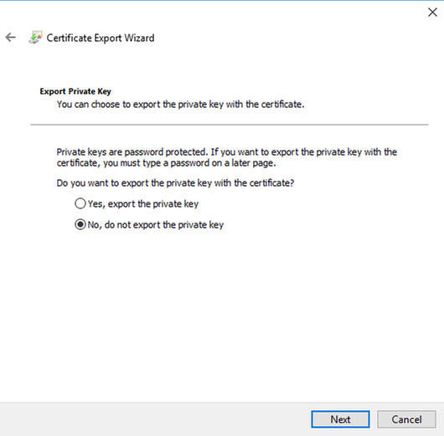
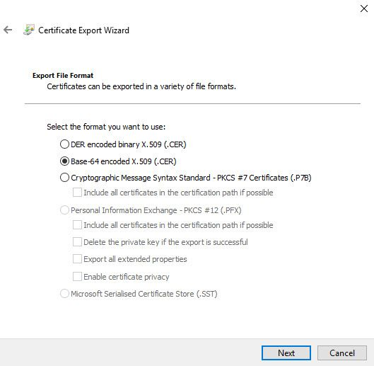
Now we have certs in place. But we need to export these so we can upload it to Azure.
To export root certificate,
Right click on root cert inside certificate mmc.
Click on Export
In private key page, select not to export private key
Select Base-64 encoded X.509 as export file format.

Slide 21
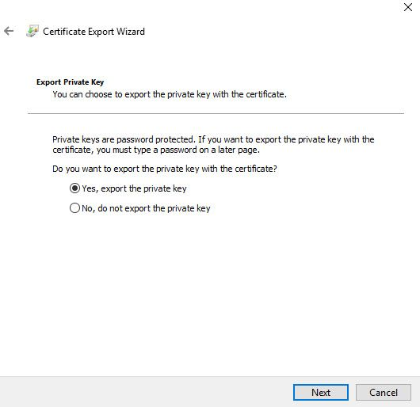
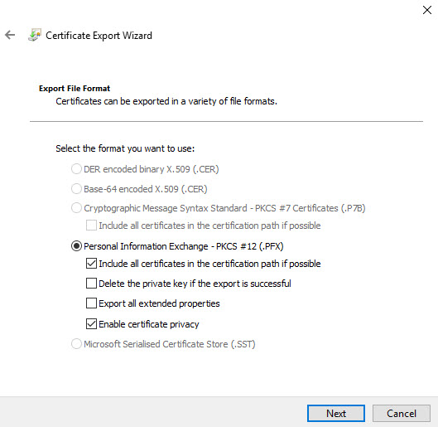
To export client certificate,
Use same method to export as root cert, but this time under private key page, select option to export private key.
Export private key
In file format page, leave the default as following and click Next

Slide 22
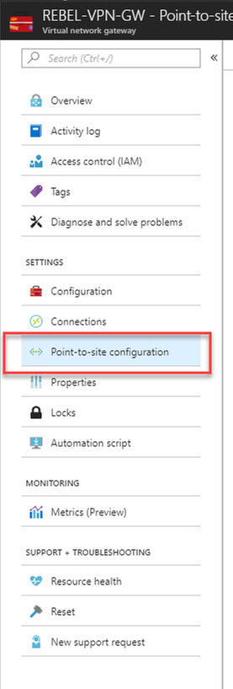
Configure Point-to-Site Connection
Next step of this configuration is to configure the point-to-site connection. In here we define client ip address pool as well. It is for VPN clients.
Click on newly created VPN gateway connection.
Then in new window click on Point-to-site configuration

Slide 23
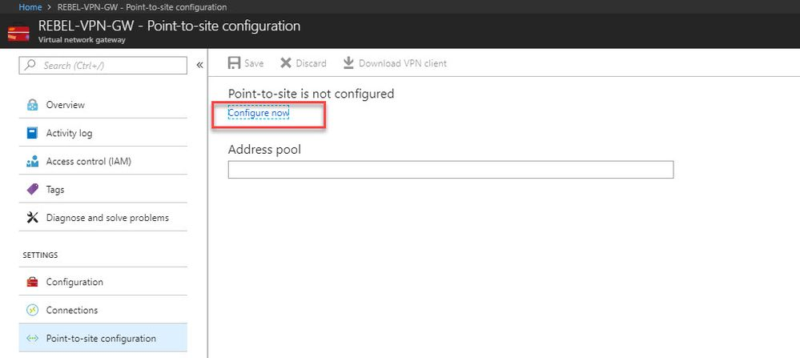
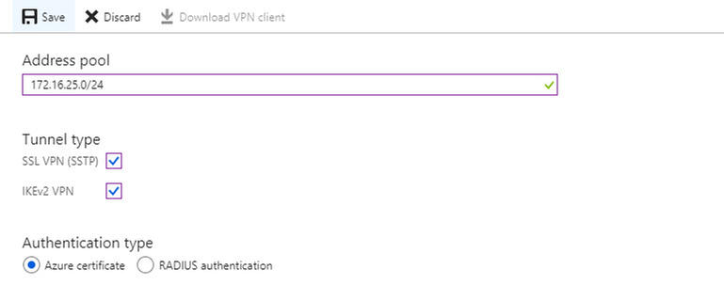
After that, click on Configure Now.
In new window type IP address range for VPN address pool. For tunnel type use both SSTP & IKEv2. For authentication type use Azure Certificates.

Slide 24
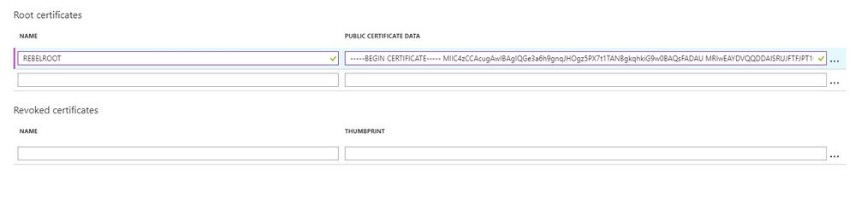
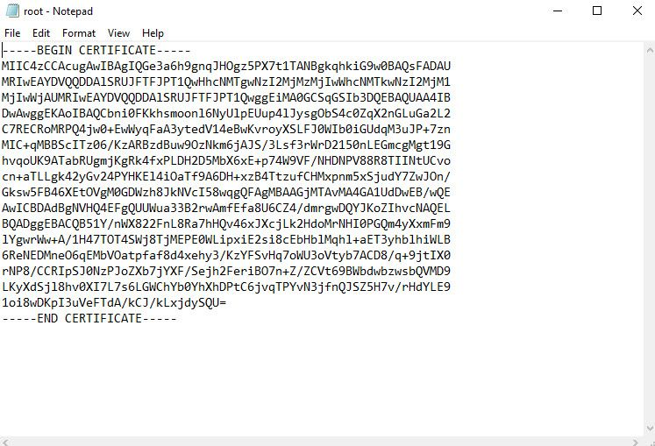
In same window there is place to define root certificate. Under root certificate name type the cert name and under public certificate data, paste the root certificate data ( you can open cert in notepad to get data).

Slide 25
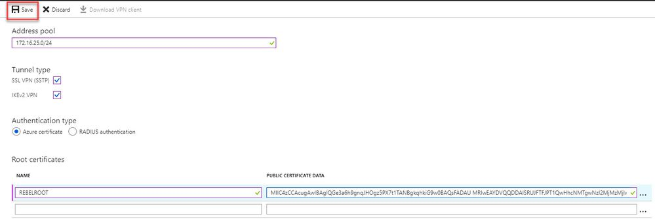
Then click on Save to complete the process.

Slide 26
Testing VPN connection
Now we have finished with configuration. As next step, we need to test the connection. To do that log in to the same pc where we generate certificates. If you going to use different PC, first you need to import root cert & client certificate we exported.
Log in to Azure portal from machine and go to VPN gateway config page.
In that page, click on Point-to-site configuration
After that, click on Download VPN client.
Then double click on the VPN client setup. In my case I am using 64bit vpn client.

Slide 27
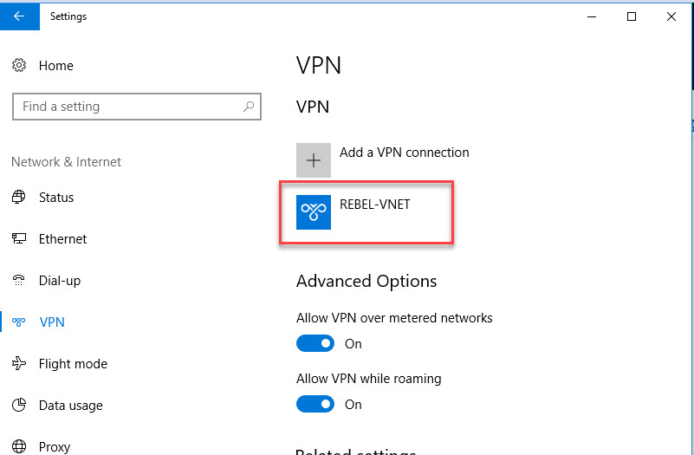
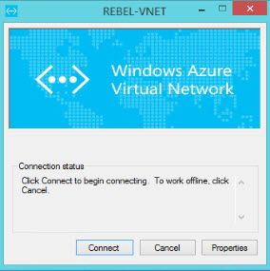
After that, we can see new connection under windows 10 VPN page.
Click on connect to VPN. Then it will open up this new window. Click on Connect in there.

Slide 28
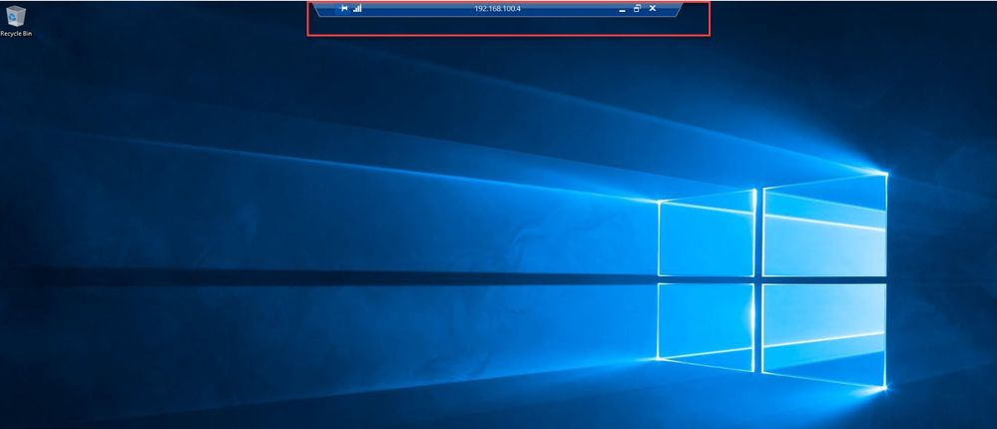
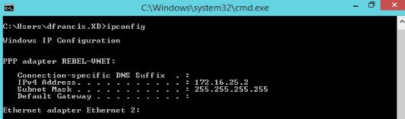
Then run ip config to verify ip allocation from VPN address pool.
In VPN gateway page also, I can see one connection is made.
I have a VM setup under new virtual network we created.
As expected, I can RDP to this via VPN.

Slide 29
Conclusion
With all those steps we have cmpleted the configration of Point-to-Site VPN and also checked the connection. This solution is useful for telecommuters who want to connect to Azure VNets from a remote location, such as from home or a conference. P2S VPN is also a useful solution to use instead of S2S VPN when you have only a few clients that need to connect to a VNet.

Slide 30
Future Scope
A P2S VPN gateway would be helpful for an organization who wants to secure their data since is provide security for estiblishing connection between the virtual network and the client computer.
A P2S VPN gateway would be helpful for an organization when they have only a few clients that need to connect to a VNet and they wants to connect to the VPN from remote location.

Slide 31
THANK YOU

